Slide 1
Brain Tumor Detection Using Tensor Flow SUPERVISOR : DR. JOSEPH SUNDARAM D. Nithya– AP23110020058 T.Kavya – AP23110020056 K. Deeksha – AP23110020064 R. Manvitha – AP23110020134 K. Manasa Sri– AP23110020135 P. Maneesha– AP23110020138

Slide 2
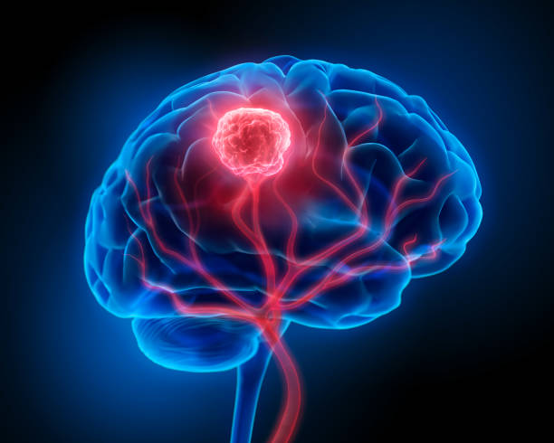
INTRODUCTION
Tumor detection is vital for early diagnosis and treatment. Manual analysis of medical images can be slow and error-prone. Using TensorFlow, a powerful AI tool, we can train models to detect tumors in MRI or CT scans accurately. This helps doctors make faster and more reliable decisions, improving patient care.

Slide 3
PROBLEM STATEMENT
Detecting tumors in medical images like MRI and CT scans is a challenging and time-consuming task. Manual analysis by doctors can lead to errors due to image complexity and human fatigue. There is a need for an automated system that can accurately detect and classify tumors to support faster and more reliable diagnosis. This project aims to develop a deep learning-based solution using TensorFlow to identify tumors in medical images and assist healthcare professionals in making better decisions.

Slide 4
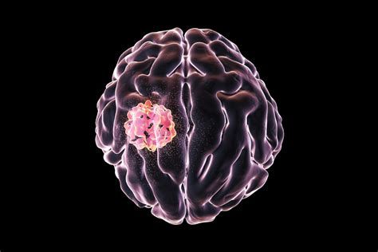
.
GOAL AND EXPECTED OUTCOMES
Goal
To develop an AI-based system using TensorFlow that can automatically detect tumors in medical images like MRI or CT scans with high accuracy and assist doctors in early diagnosis and treatment.
Expected Outcomes
1.A trained deep learning model that can identify tumors in images.
2.Improved speed and accuracy in tumor detection.
3.A user-friendly interface for uploading and analyzing medical images.
4.Reduced workload for doctors and support in making better decisions.
5.A reliable tool to assist in early and accurate cancer diagnosis.

Slide 5
System Design and Methodology
1. Data Collection: Medical images (MRI/CT) are collected from public datasets for training and testing.
2. Data Preprocessing: Images are resized, normalized, and labeled. Augmentation is done to improve model performance.
3. Model Building: A Convolutional Neural Network (CNN) is built using TensorFlow to learn patterns and detect tumors.
4. Training the Model: The model is trained on the preprocessed images, adjusting weights to improve accuracy.
5. Testing and Validation: The model is tested with new images to check how well it detects tumors.
6. Deployment: The trained model is deployed so it can be used in real-world applications.

Slide 6
IMPACTS, BENEFITS, CHALLENGES
Impacts:
Improved Accuracy in tumor detection
Faster Diagnosis for quicker treatment
Cost Efficiency by reducing manual labor
Enhanced Patient Outcomes through early detection
Accessible Healthcare in remote areas
Benefits:
Consistency with error-free results
Scalability for large data sets
Real-Time Feedback to doctors
Data-Driven Insights for research
Enhanced Doctor Efficiency in handling cases
Challenges:
Data Quality and large dataset needs
Model Generalization across diverse scans
Resource Intensive in terms of computation
Interpretability and trust in AI decisions
Regulatory & Ethical Issues in healthcare

Slide 7
TESTING AND RESULTS
TESTING
RESULTS
Data Split: 70% training, 95% validation, 15% testing.
Evaluation Metrics: Accuracy, Precision, Recall, F1-Score.
Cross-Validation: Multiple splits to ensure generalization.
Confusion Matrix: For performance visualization.
Model Performance: Aiming for 95% validation accuracy, with high Precision, Recall, and F1-Score.
Visual Validation: Manually verified by medical experts.
Real-World Testing: Evaluated on new, unseen medical images.
Final Outcome: Model deployed for real-time use.

Slide 8
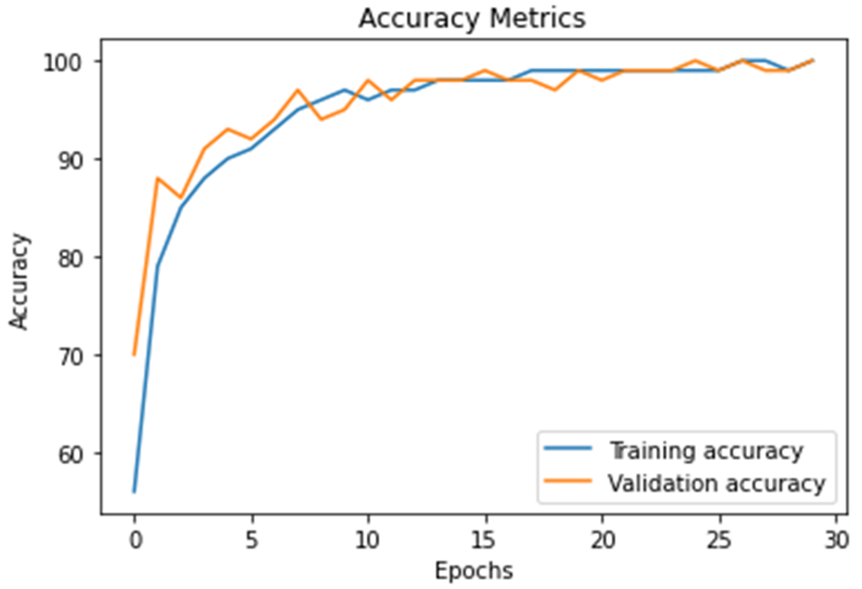
CONCLUSION
The tumor detection system using TensorFlow is a powerful tool to make medical image analysis faster and more accurate. It helps find and identify tumors in MRI and CT scans with fewer mistakes and in less time. The goal is to reach 95% accuracy, which can help doctors detect tumors early and improve patient care. In the future, adding features like real-time detection and combining it with other medical tools will make the system even more helpful for doctors and researchers.

Slide 9
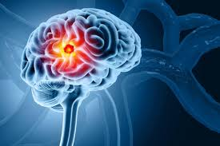
THANK YOU

